Slide 1

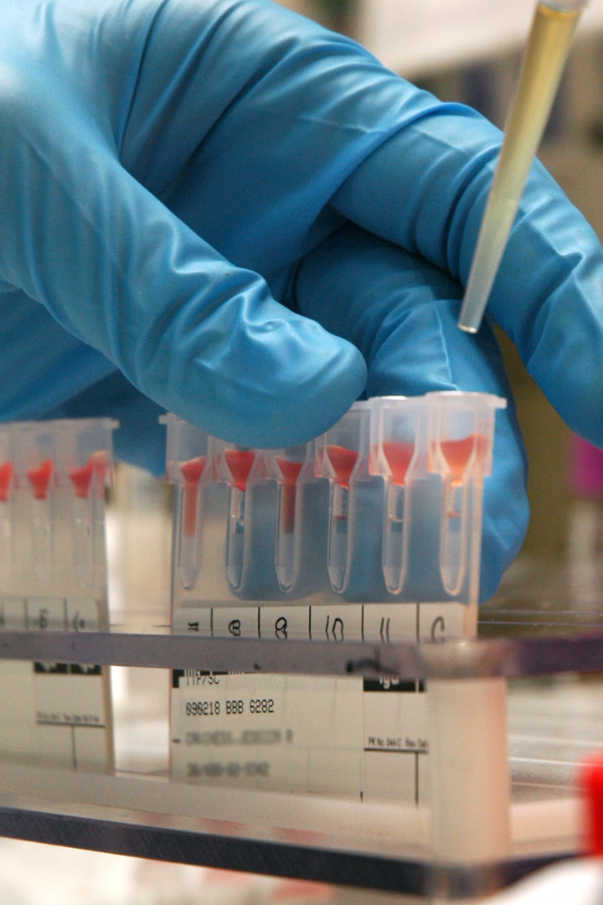

RedDrops - Connecting Blood Banks and Patients

Slide 2
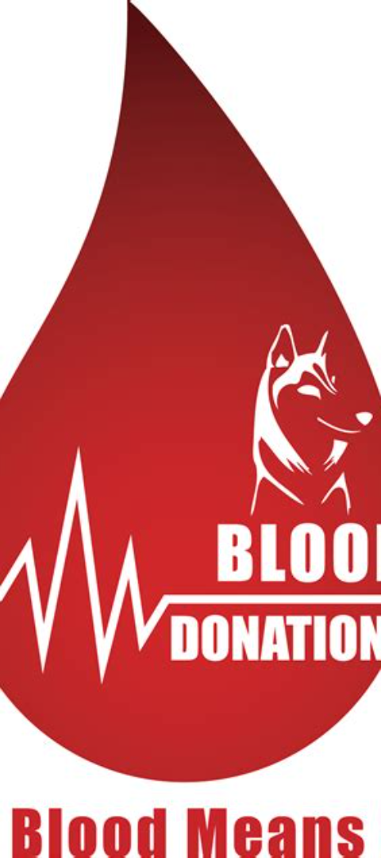
RedDrops is a blood bank website that connects blood banks and patients in need. By providing a platform for blood banks to store and manage blood group information and for patients to search for available blood units, RedDrops streamlines the blood donation process.

Slide 3

How RedDrops Works
1
Blood Bank Functionality
2
Patient Functionality
Blood banks can store and update blood group information and available units in their respective blood banks.
Patients can search for blood availability based on their district, required blood group, and the number of units needed.

Slide 4
Benefits of RedDrops
Convenient Matchmaking
Time and Effort Reduction
Efficiently connects blood donors with patients, ensuring timely access to blood units.
Reduces the overall time and effort involved in the blood donation process.

Slide 5
Conclusion
RedDrops offers convenient and efficient access to blood units for patients while reducing the effort required by blood banks.
Both blood banks and patients are encouraged to actively engage with RedDrops for a streamlined and effective blood donation process.

